Slide 1


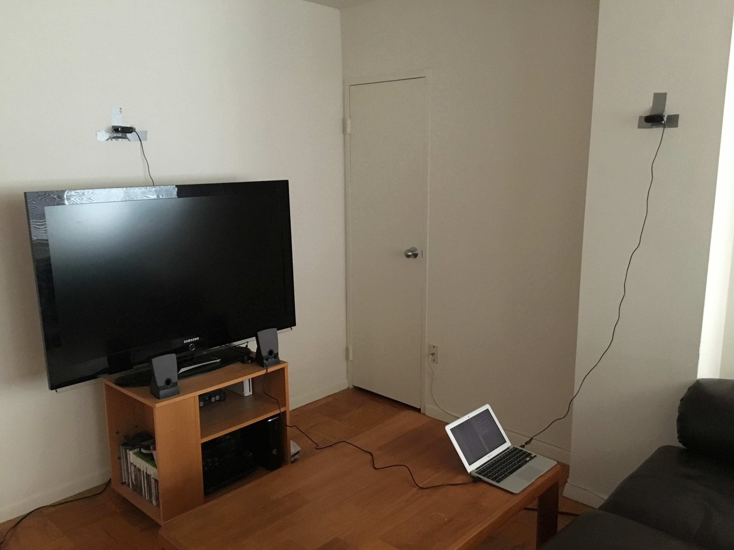
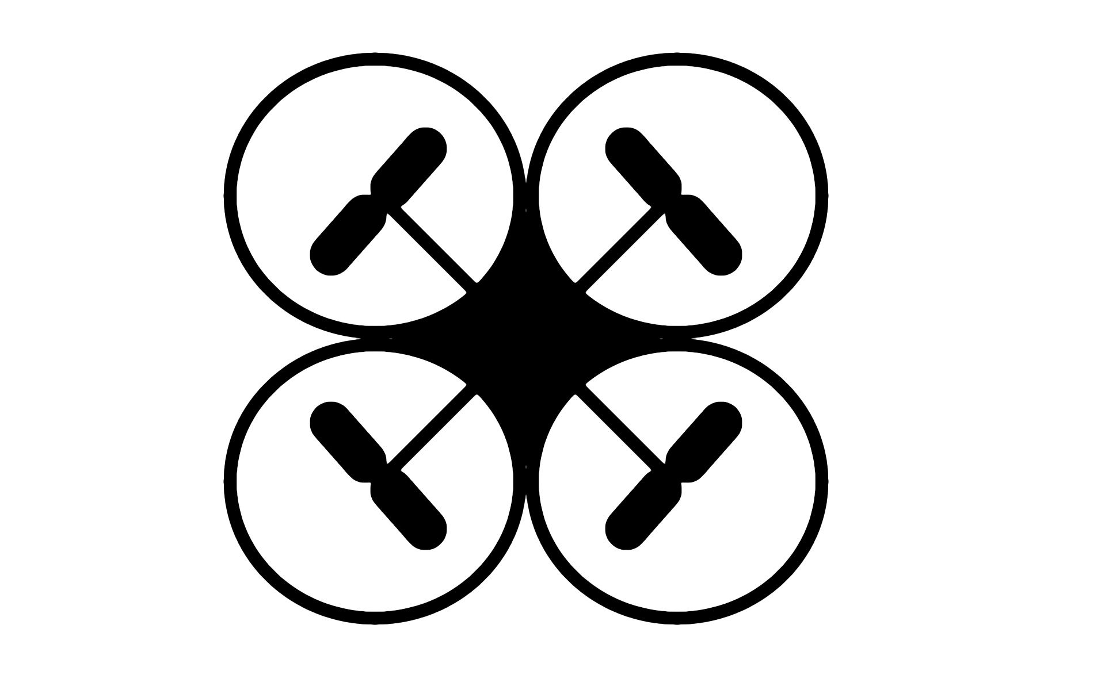
CSCI 4244: Capstone Design Project
Drone Recognition and Tracking Suite
Christoph von Braun
Project Overview
Demonstration Setup
The Drone Recognition and Tracking Suite (DRATS) is a system that identifies and tracks drones flying autonomously in a monitored area. The program uses two webcams to find the drone using color, then runs that data through an algorithm that computes the absolute coordinates of the drone in meters. This is a prototype of a system that demonstrates what a future drone safety infrastructure could look like, as drones become more and more commonplace in society.
Two webcams, circled in green, are mounted to the walls of the monitored area. They each scan the room, looking for a drone that will be marked with red cardboard. The system then needs to convert the initial identified location, a value in pixels of the camera (x, y), into the global coordinate system, indicated by the orange arrows (x, y, z). This final coordinate set will be in meters.
Image from Runtime
The image on the right showcases what DRATS shows during runtime. The drone has been identified and is labeled with a green dot. In the console, we can see the coordinates that DRATS has calculated, which are shown in meters relative to the room’s corner. The image is what one of the cameras sees; the system needs two cameras on perpendicular walls to pick up the ‘depth’ dimension that one camera lacks.
1.38, 1.65, 2.61

